Slide 1
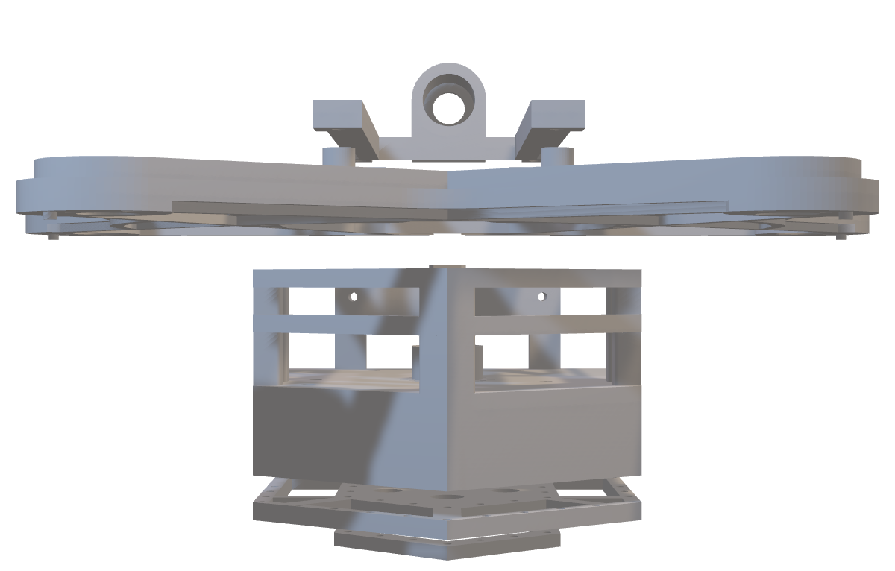
ARTEx
All-terrain Robotic Transportation and Exploration System
By Samuel Akintomide

Slide 2
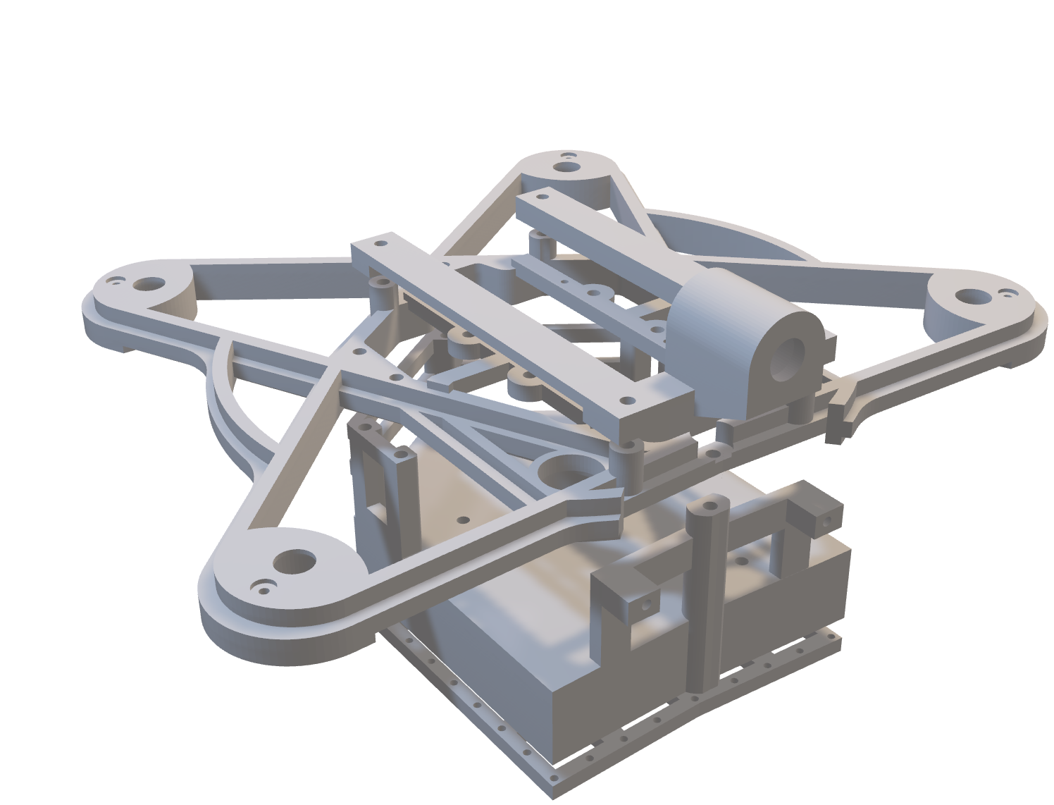
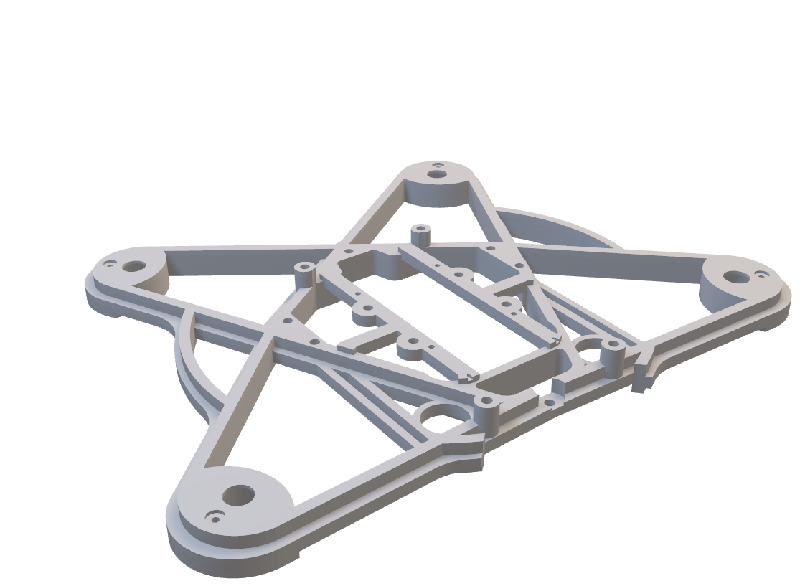
ARTEx
ARTEx is an All-terrain Robotic Transportation and Exploration System.
This vehicle has the ability of flight and use on ground.
The primary objective of this Robot is to transport medical supplies from A – B in both developed and undeveloped countries. Secondary objectives is for the drone to be used in exploration or testing facilities as the name suggests, so that it can read data in the air and even carry out surveillance.
All-terrain Robotic Transportation and Exploration System
By Samuel Akintomide

Slide 3
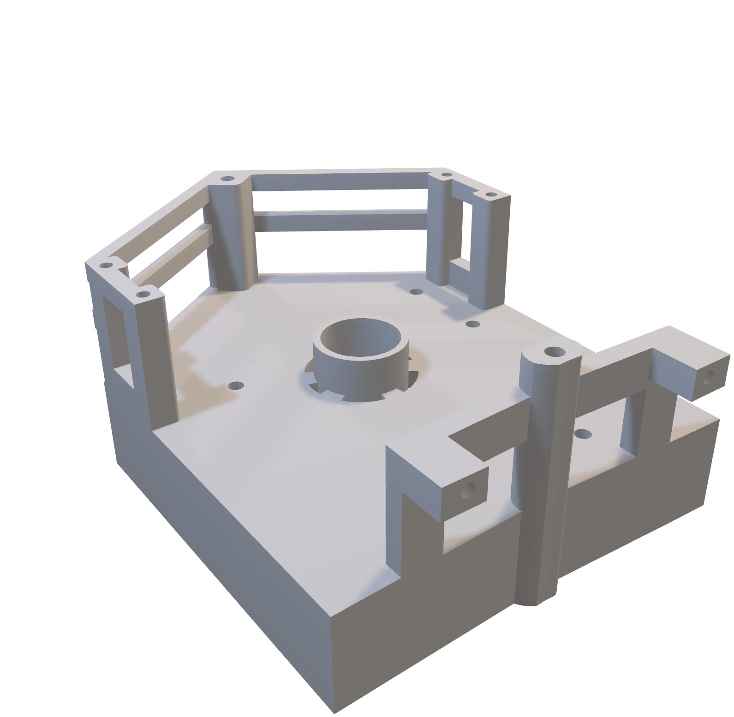
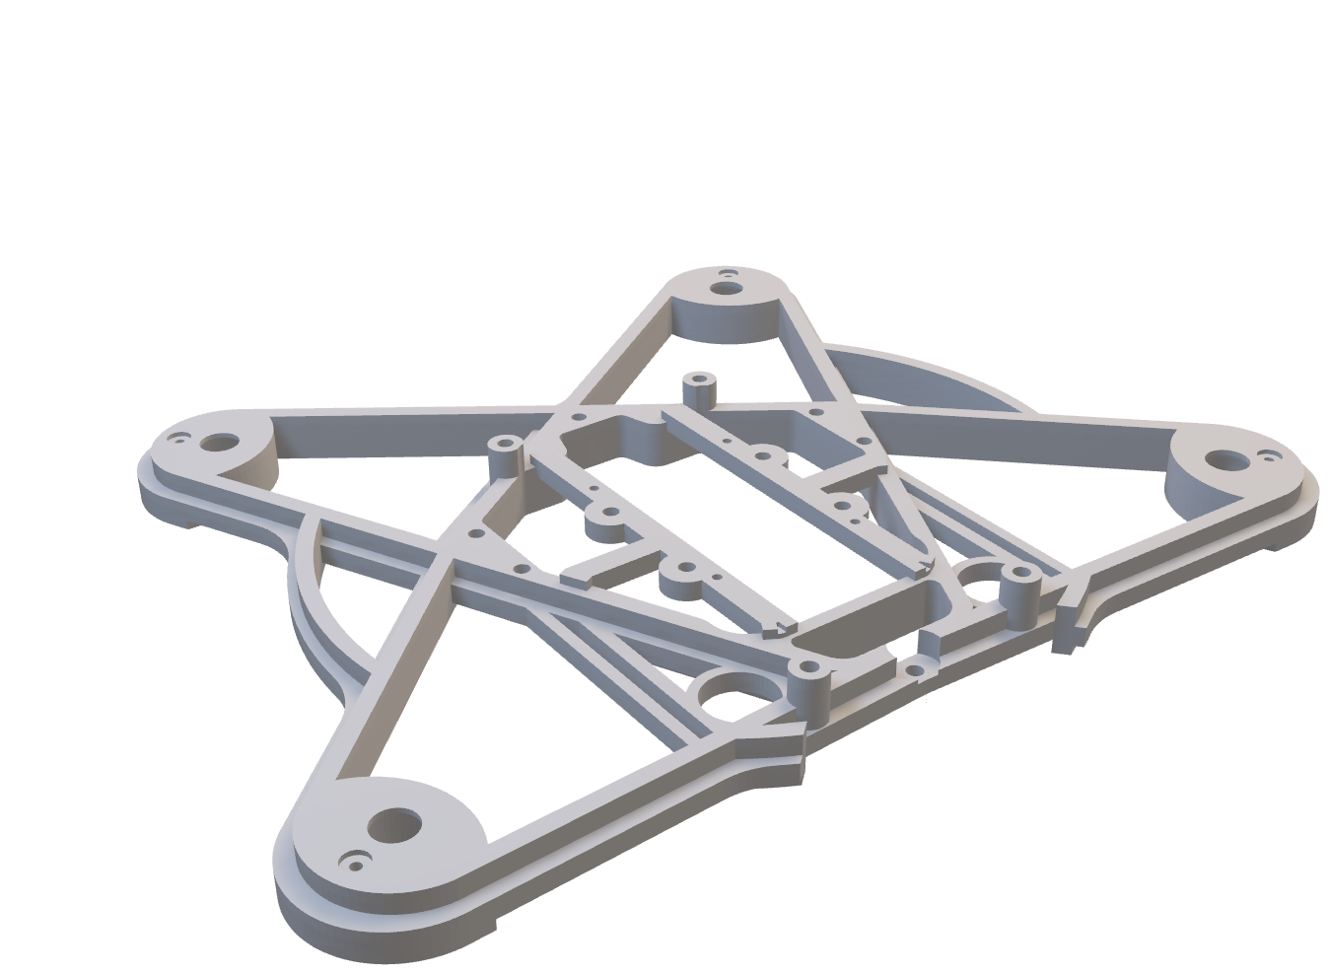
The Upper Frame
The Upper frame is what holds the components used mainly for the drone functionality.
It has 4 areas for motors to slot into and area in the centre for the different microcontrollers to attach to.
The area in the centre holds 3 different microcontrollers.
It also has a number of areas used for the organisation of the wires.

Slide 4
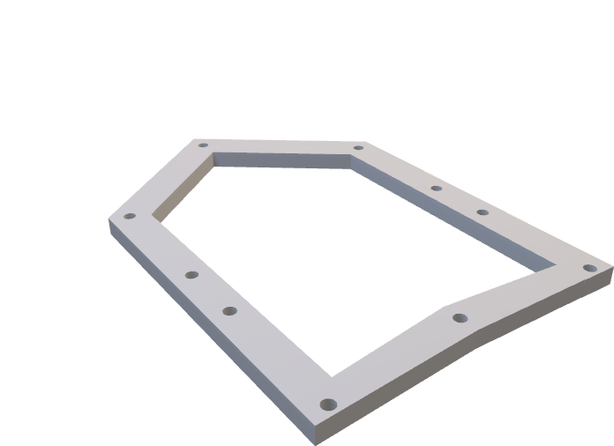

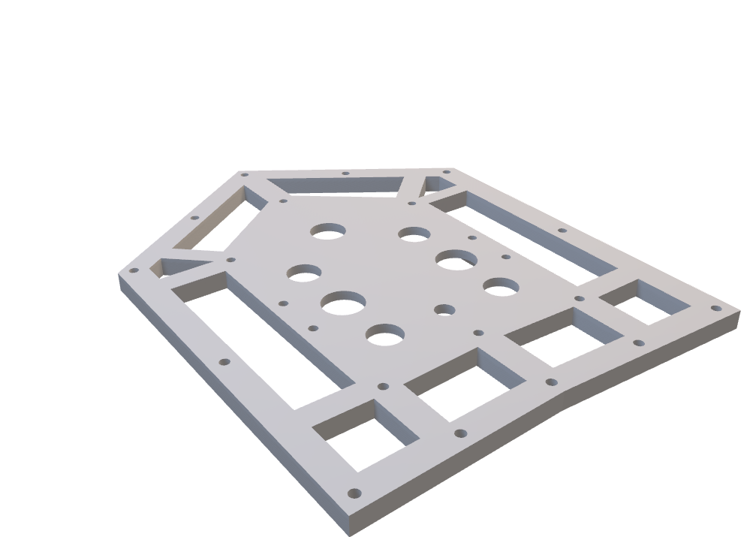
The base is a hovercraft. This will aid it when travelling along a variety of surfaces. Compared to conventional boats, hovercrafts are far superior in performance due to reduced drag and lower horsepower requirements meaning higher speeds and lower fuel consumption.
The main reason for integrating the designs of a hovercraft is that hovercrafts excel in speed and perform not just on water but on rough surfaces as well. They fall into the three primary categories being amphibious, non-amphibious, and semi-amphibious. Weight also plays a crucial role in the design, prompting the use of lightweight material
The Lower Body

Slide 5
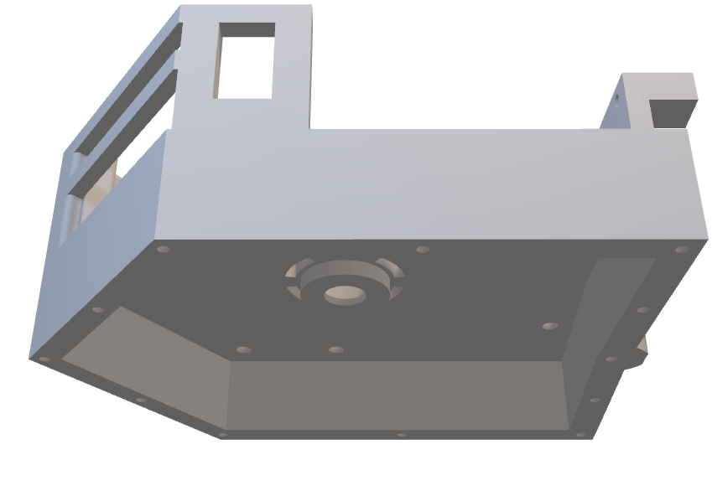
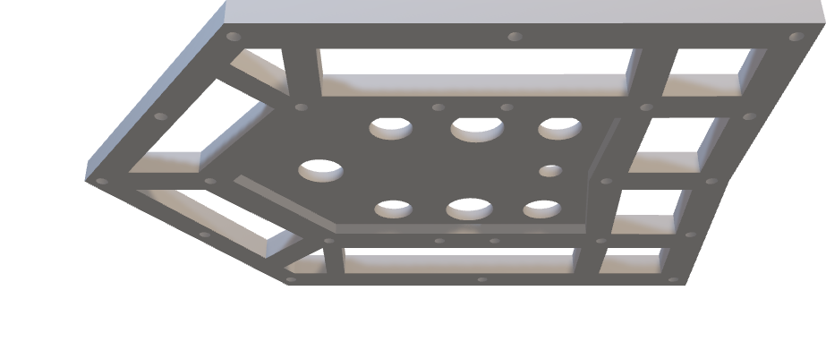
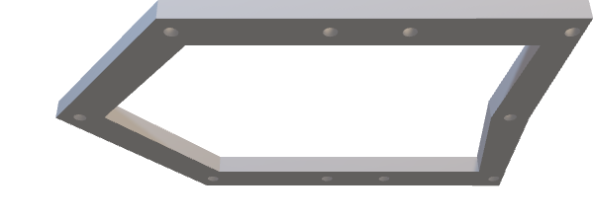
The lower body is comprised of 4 different pieces.
The main point of the body is the hold the central motor used for inflating the skirts and the IR sensor used for distance identification so that the user doesn’t have to manually inflate the skirts themselves.

Slide 6
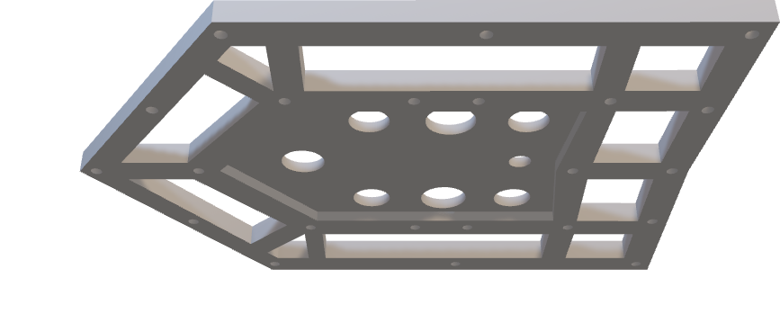

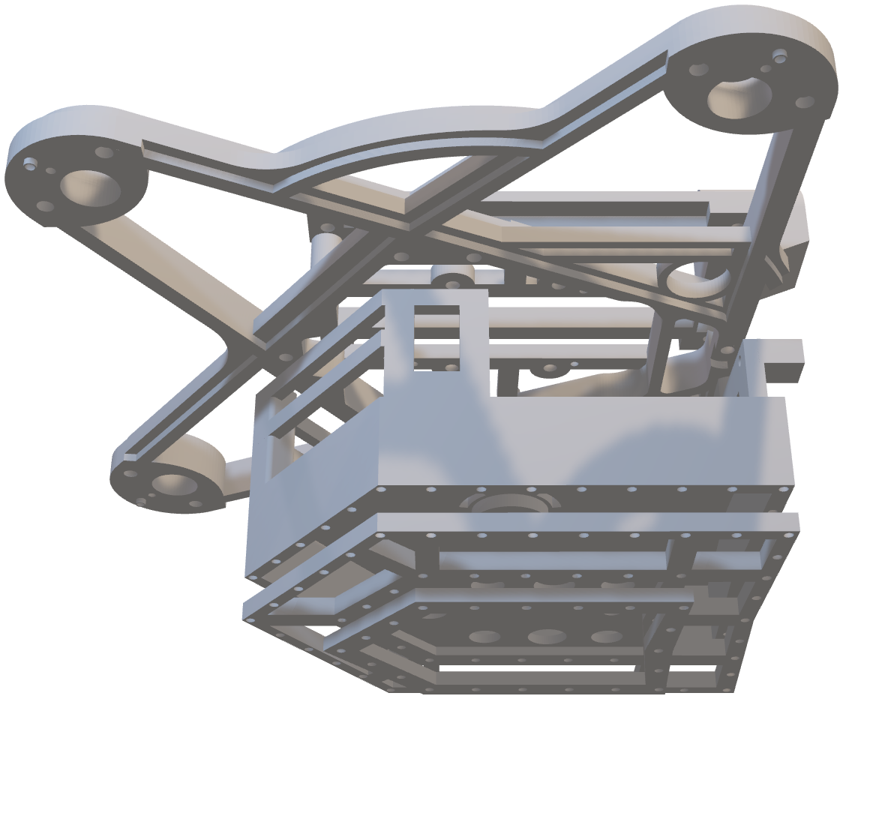
On the bottom, the lower body holds the skirt. To hold the skirt in place the lower body connects to two skirt clips.
These skirt clips hold the skirt in place and allow air to travel out through the bottom to enable the floating affect.
There are holes surrounding this motor holder to aid air intake.

Slide 7
The full build looks like so
This build is smaller in height than and allows for the addition of multiple components such as the BMP280, ADXL345 and even an IR sensor.

Slide 8
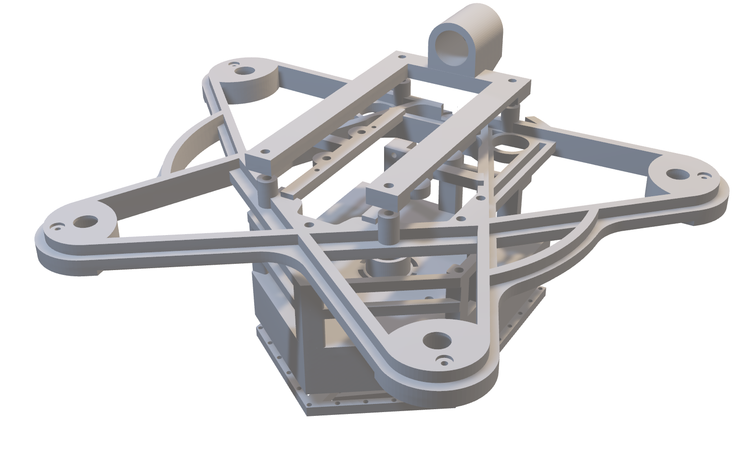
THE END

Slide 9
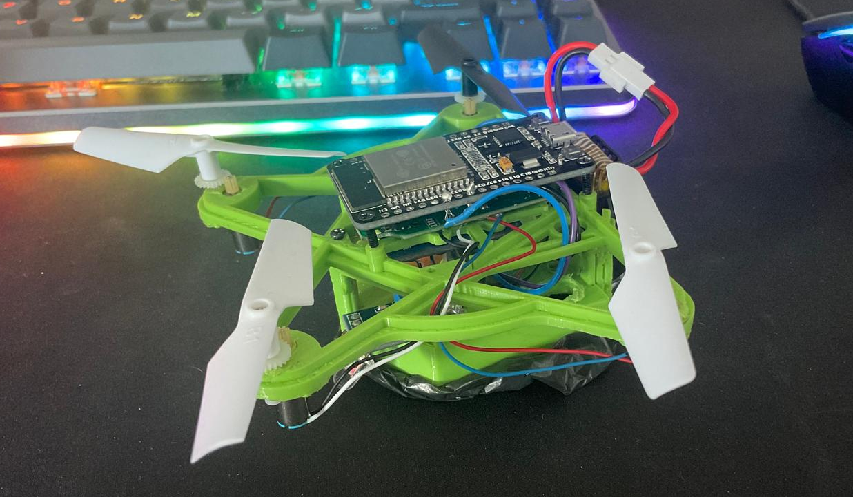
THE END

